Slide 1
Underlying Philosophies of dispute resolution
Richard Traub
Traub Lieberman Straus & Shrewsberry LLP

Slide 2
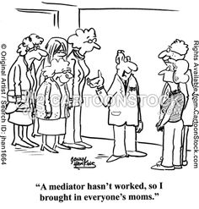

Slide 3
Philosophies of mediation
Ownership
Empowerment
Impartiality
No-Blame Approach
Confidentiality
Adult-Adult Relationship-Not Parent -Child

Slide 4
Ownership
Those involved in a dispute have the responsibility to resolve it – not the mediator.
  Mediator is to help them resolve it for themselves.
  It is only the parties that can resolve the dispute.
  No ownership means no resolution
There is rarely a party that is clearly right and clearly wrong.
Lack of Ownership is the Belief:
  That the only option for resolution is to build and bigger and bigger case
  That you have to abdicate responsibility for your situation for anything to change

Slide 5
empowerment
Latest Buzz Word?
Process by which someone who feels unable to change something is supported in finding ways of doing so.
  New ways of communicating
  A different way of acting or behaving
  A different way of perceiving their situation

Slide 6
Impartiality
More commonly recognized aspect of the role of the mediator
The process must be untainted by the mediator’s biases and prejudices (even though they exist)
Stereotyping is as bad a racism, sexism or any form of bias.
Look at the person next to you:
  What sport do they play
  What type of music do they like
  What type of work do they do
  We all stereotype
  But if we are aware of them, we can avoid destructive analysis

Slide 7
No-blame approach
The purpose of mediation is not to investigate or try to find the “truth” about a situation. It simply acknowledges that there is a problem and assists in in finding another way of looking at the situation and responding to it.
Challenge the behavior not the person.

Slide 8
confidentiality
Passing on information, even that which may seem innocuous can exacerbate a difficult situation as it adds to the insecurity of those involved
If people think that their confidences will be disclosed, they will be less likely to share their vulnerabilities. Who know how others will interpret those issues.
Confidentiality is crucial – it must be treated with reverence.

Slide 9
Adult-adult relationship; not parent-child
We must remember that we are not relying on the mediator to solve their problems; rather, the mediator is assisting.
Any practice that implies the mediator is the expert in solving a dispute for the parties changes the role from adult-adult to parent-child and ultimately disempowering of the litigant or party.
Parent child approach often results in entrenching the party in their “victimhood” AND create a dependency relationship between the person and the mediator.

Slide 10
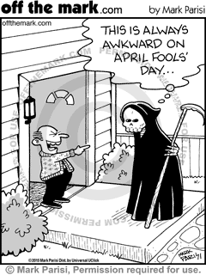
assumptions

Slide 11
A word about Assumptions
Go back to our test. Look at the person next to you.
  Do they take sugar in their coffee or tea?
  What is their favorite sport?
  Favorite animal?
  What political party to they support?
  What is their favorite movie?
We all make assumptions but are we open to questioning them
Just answering those questions is a form of stereotyping
If that person knows your assumptions, will they be offended
Bottom line – Listen; Summarize; Question

